Slide 1
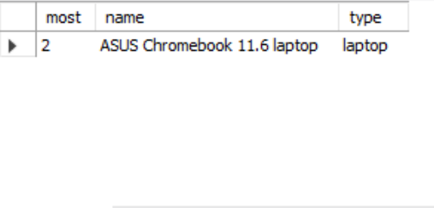
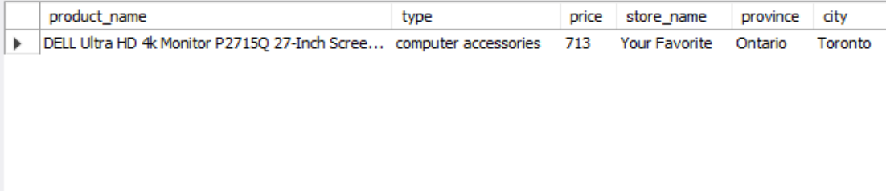
Queries
Find the product that has been ordered the most times.
SELECT COUNT(o.pid) AS most,
p.name,
p.type
FROM product AS p
JOIN orderitem AS o
ON p.pid = o.pid
GROUP BY p.name, p.type
ORDER BY most DESC
LIMIT 1;
Find all the orders that were placed for products that are sold by stores in the city of Toronto.
SELECT p.name AS product_name, p.type, o.price, s.name AS store_name, s.province, s.city FROM product AS p JOIN orderitem AS o ON p.pid = o.pid JOIN store AS s ON p.sid = s.sid WHERE s.city = "Toronto";

Slide 2
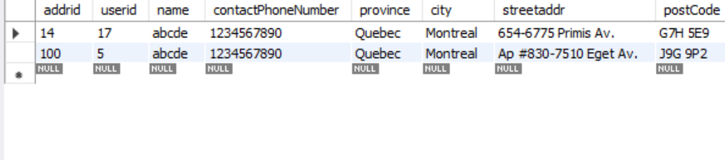
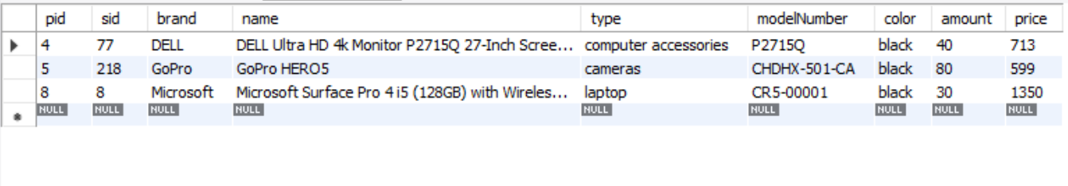
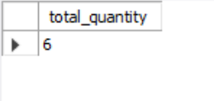
Queries
Update the name and contact phone number of the address where the province is Quebec and city is Montreal.
SELECT *
FROM address
WHERE province = 'Quebec'
AND city = 'Montreal';
Create a report of all products whose price is above average price using subquery.
SELECT * FROM product WHERE price > (SELECT AVG(price) FROM product);
Query the total quantity of products from store with storeid 8 in the shopping cart using a subquery.
SELECT SUM(quantity) AS total_quantity FROM save_to_shopping_cart WHERE pid IN ( SELECT pid FROM product WHERE sid = 8 );

Slide 3
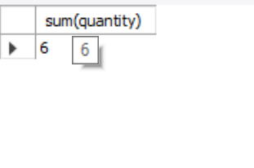
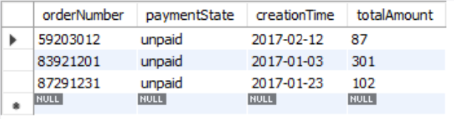
Queries
Display the total quantity of products from store with storeid 8 in the shopping cart
SELECT * FROM save_to_shopping_cart;
SELECT SUM(quantity) FROM save_to_shopping_cart JOIN product ON save_to_shopping_cart.pid = product.pid WHERE product.sid = 8;
Update the payment state of orders to unpaid which were created after year 2017 and with a total amount greater than 50
UPDATE orders SET paymentState = 'unpaid' WHERE YEAR(creationTime) = 2017 AND totalAmount > 50;
select * from orders
where year(creationTime)=2017
and totalAmount>50;

Slide 4
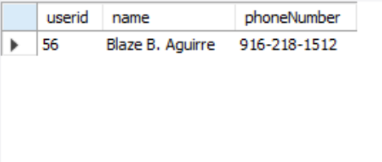
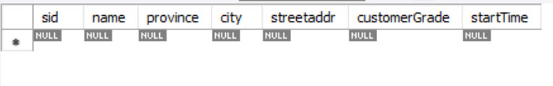
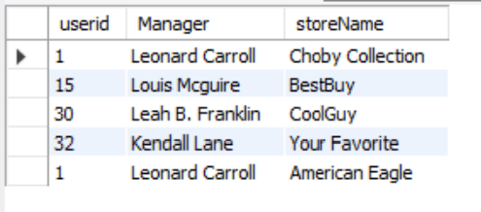
Queries
Find all the details of the buyers who have a phone number that starts with the contact number 91.
SELECT b.userid, u.name, u.phoneNumber FROM buyer AS b JOIN users AS u ON b.userid = u.userid WHERE phoneNumber LIKE "91%";
Delete the store which opened before year 2017
DELETE FROM store WHERE YEAR(startTime) < 2017;
Retrieve all stores and their associated managers
SELECT m.userid, u.name AS Manager, s.name AS storeName FROM manage AS m JOIN users AS u ON m.userid = u.userid JOIN store AS s ON m.sid = s.sid;

Slide 5
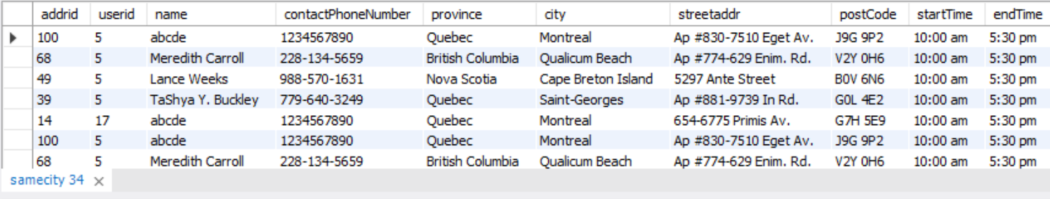
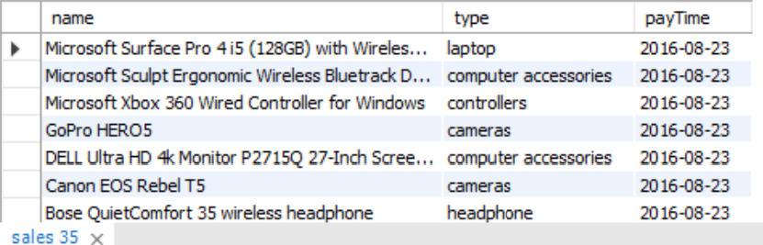
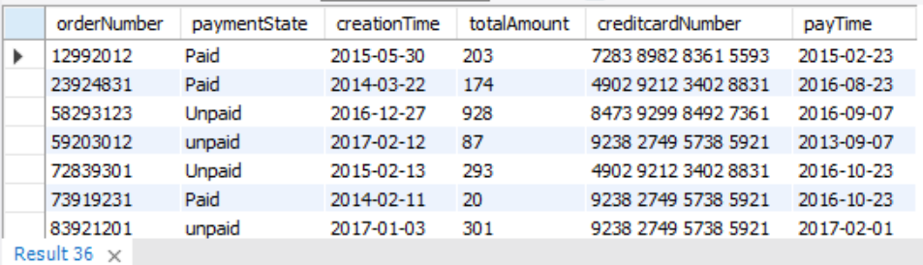
Queries
Display the address, starttime and endtime of the service points in the same city as that of userid 5
SELECT * FROM samecity sc WHERE sc.city = ( SELECT city FROM address WHERE userid = 5 );
Create a view of all product sales in 2016.
CREATE VIEW sales_2016 AS SELECT p.name, p.type, pa.payTime FROM product p JOIN payment pa ON p.pid = pa.pid WHERE pa.payTime >= '2016-01-01' AND pa.payTime < '2017-01-01';
SELECT * FROM sales_2016;
Retrieve all credit card payments and their associated order information
SELECT o.*, p.creditcardNumber, p.payTime FROM orders AS o JOIN payment AS p ON o.orderNumber = p.orderNumber;

Slide 6
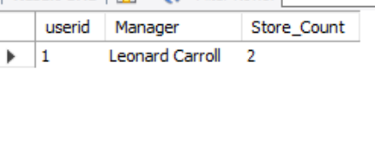
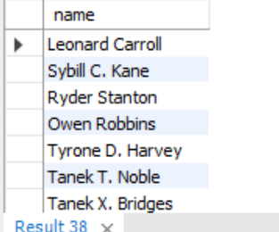
Queries
Find all sellers who manage more than one store.
SELECT m.userid, u.name AS Manager, COUNT(m.sid) AS Store_Count FROM manage AS m JOIN users AS u ON m.userid = u.userid GROUP BY m.userid, u.name HAVING COUNT(m.sid) > 1;
Retrieve the names of buyers who have made at least one order and have also left a comment on a product.
SELECT DISTINCT u.name FROM users u JOIN buyer b ON b.userid = u.userid JOIN orders o ON b.userid = o.userid JOIN comments c ON b.userid = c.userid;

